Slide 1

Design Workshop
Hack Club 2019-02-15

Slide 2
What is Design?
2 Main definitions:
A plan produced to show the look and function of something before it is built
An arrangement that forms a pattern or decoration
(Google “Define Design”)
So…Design is:
A plan
A pattern

Slide 3
What are some things to plan for?
Organization:
Physical: Some sort of hierarchy or structure.
Thought: How do we manage each piece of the design?
Theme:
Physical: Colours, positioning, grouping, the “pattern”
(what you normally think of when you say design)
Thought: How do each of these meet the purpose of your design.
Function:
Buttons, Input, Information.
What is the purpose of the design? What helps us achieve that?
There are TON of categories or ways to break this down, and things I will inevitably miss
But I chose to do it this way for a reason

Slide 4
Q Is there a reason I chose to break things down this way?

Slide 5
A Yes.

Slide 6

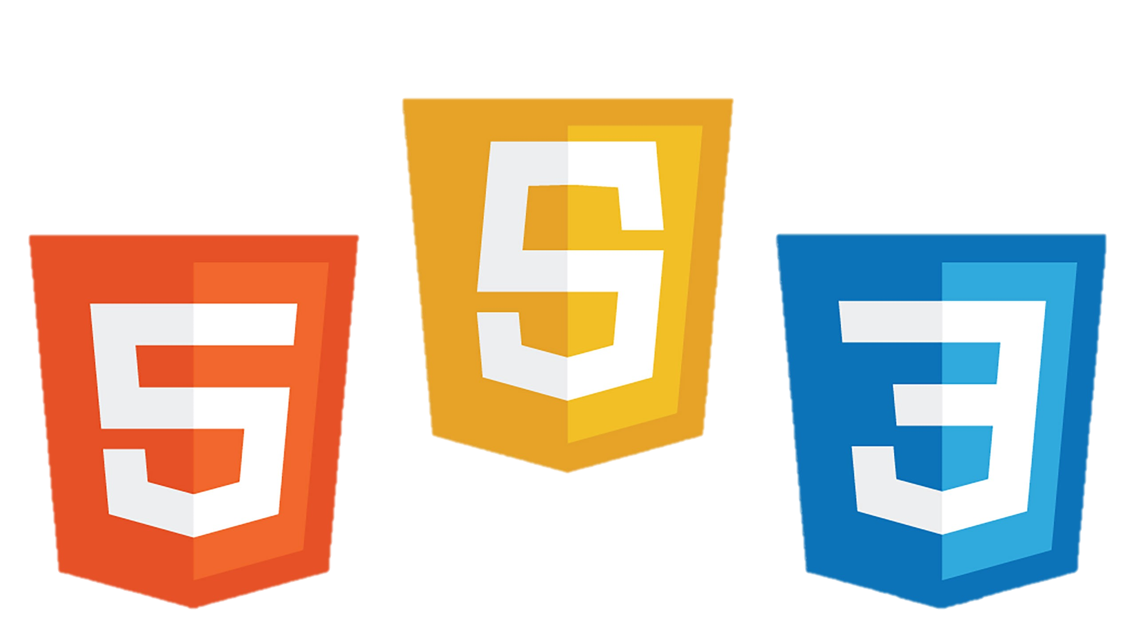
Looking into Web Design
Organization: HTML
Theme: CSS
Function: JavaScript

Slide 7
Q Okay, cool. How do I apply these to a website?

Slide 8
A Yes.

Slide 9
A Just kidding… let’s break it down.

Slide 10
Organization: (HTML)
Recall:
Physical: Some sort of hierarchy or structure.
Thought: How do we manage each piece of the design?
Physically:
The DOM manages the structure of webpages.
Framing Pages.
Managing each of the pieces:
We can link separate files (CSS, JavaScript)
Web Frameworks (React, Vue, Angular)

Slide 11
Physical Organization: (HTML)
The DOM:
Compared to 4 years ago, this is EASY
Write Semantic HTML (HTML that logically follows the flow of the page)
E.g. You should be able to locate each item in the document in the same order that you view items on the page. (Seems logical… but you’d be surprised!)
Framing Pages:
Follow semantic flow of reading. (left to right, top to bottom)
F – Frame: Important items first. (May also be referred to as an axis)
What if you had to scroll down to get to Google’s search bar? No one would use it…
Z – Frame: Content layout. (A “Z” goes left to right, top to bottom)
Great pattern to order content by importance.

Slide 12
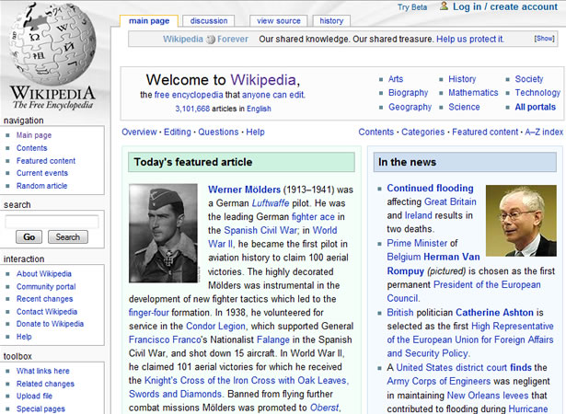
Wikipedia…

Slide 13
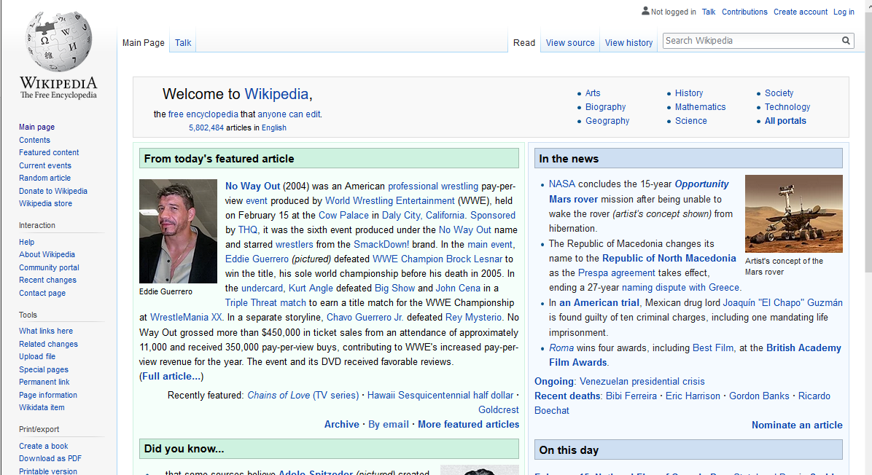
See the difference?

Slide 14
Little change, BIG difference.
Search bars belong on TOP

Slide 15
Where are the Frames?

Slide 16
F - Frame
Simple / Main Functionality
Content
Extra Functionality

Slide 17
Z - Frame
1: Important TODAY
2: Recent
Cool. Less Interesting.
3: Interesting

Slide 18
Managing Everything: (HTML)
Recall:
We can link separate files (CSS, JavaScript)
Web Frameworks (React, Vue, Angular)
We can link separate files (CSS, JavaScript)
You already know how to do this if you have been here before!
Web Frameworks (React, Vue, Angular)
TLDR: Complicated and requires dedication but very beneficial.
I will go over the big three quickly.
I suggest you do your own research if interested.

Slide 19
Managing Everything: (HTML)
Recall:
We can link separate files (CSS, JavaScript)
Web Frameworks (React, Vue, Angular)
We can link separate files (CSS, JavaScript)
You already know how to do this if you have been here before!
Web Frameworks (React, Vue, Angular)
TLDR: Complicated and requires dedication but very beneficial.
I will go over the big three quickly.
I suggest you do your own research if interested.

Slide 20
Web Frameworks:
Angular: (2010)
Oldest, most users. Made by Google.
Seems to be catered to Google developers.
Used by Google, Wix
React: (2013)
My Preference. Made By Facebook
Seems to be catered to all developers.
Used by Facebook, Instagram, Uber, Netflix & MANY more
Vue: (2014)
Got shadowed by React. Made by Ex-Google Employee.
Has been picking up major traction in recent years.
Seems promising, some companies are moving over.

Slide 21
Theme: (CSS)
Recall:
Physical: Colours, positioning, grouping, the “pattern”
(what you normally think of when you say design)
Thought: How do each of these meet the purpose of your design.
Physically:
What is your aesthetic?
What are you using to represent different elements?
(Groups, Title vs. Body)
Design Purpose:
The meat and potatoes of this Presentation.
Next slide.

Slide 22
Designing with Purpose:
Importance:
Remember the saying “less is more”
Well LESS of something else leaves MORE space for the important things.
White space is key to grouping and isolating these important things.
Start with content first, placing the most important things first.
Still feels empty?
Now add some of those “Extra” visuals or icons.
We will go over some examples

Slide 23
Designing with Purpose:
Contrast:
If something is important, it should stand out.
But don’t let EVERYTHING stand out, then nothing ends up standing out.
Consider accessibility though. Make sure fonts stand out enough to read.
Grouping:
Similar things should be grouped together, simple.
Be sure to think about people using it.
Make the things most likely to be used the most, easiest to access.

Slide 24
Function: (JavaScript)
Recall:
Buttons, Input, Information.
What is the purpose of the design? What helps us achieve that?
A Quick Overview:
Make your functional elements purposeful.
Again, less is more. Leave room for the important stuff.
Even posters have functional components.
The goal of a poster is to deliver information.
Aesthetic: Catches attention
Typography: Delivers information
(The more clear this part is, the more functional your poster will be)

Slide 25
ANY Questions?

Slide 26
Let’s Get to the Fun Part
Feel free to ask me Questions on Slack or Facebook
Xavier Chanthavong

